Slide 1
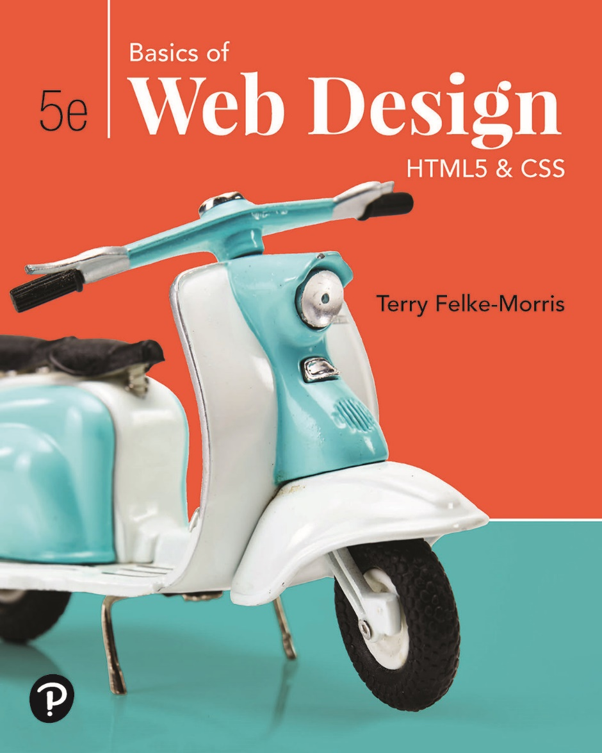
Basics of Web Design
Fifth Edition
Chapter 8
Responsive Layout Basics Key Concepts
Slide in this Presentation Contain Hyperlinks. JAWS users should be able to get a list of links by using INSERT+F7
Copyright © 2025 Pearson Education, Inc. All Rights Reserved
Notes:
If this PowerPoint presentation contains mathematical equations, you may need to check that your computer has the following installed:
1) Math Type Plugin
2) Math Player (free versions available)
3) NVDA Reader (free versions available)

Slide 2
Learning Outcomes
Describe the purpose of C S S Flexible Box Layout
Configure a web page that applies C S S Flexible Box Layout
Configure web pages for mobile display using the viewport meta tag
Apply responsive image techniques including the new H T M L 5 picture element

Slide 3
C S S Flexible Box Layout aka flexbox
Purpose: Provide for a flexible, responsive layout https://www.w3.org/TR/css-flexbox-1/
Best used for one dimension – a row or a column
The display property
  Configures a flexbox container
display: flex;
Flex Item -- a child element of the flex container
The flex-wrap property
  Determines whether flex items are displayed on multiple lines
  Values are nowrap (default), wrap, wrap-reverse
The flex-direction property
  Configures the flow direction
  Values are row,(default), column, row-reverse, and column-reverse

Slide 4
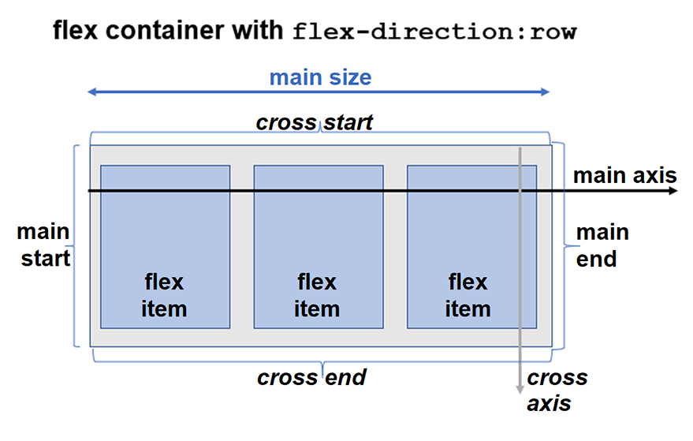
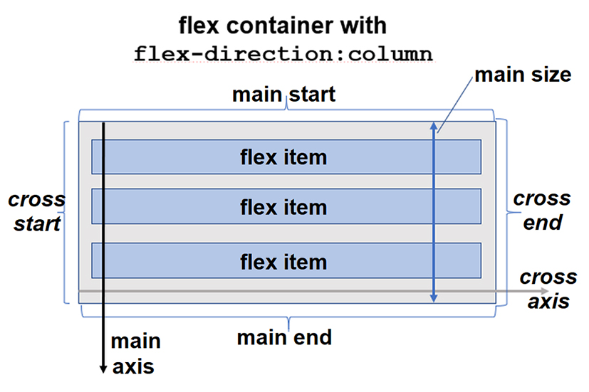
Diagram of a Flex Container

Slide 5
CSS Flexible Box Layout Module
CSS Flexible Box Layout Module
Before the Flexible Box Layout module, there were four layout modes:
Block, for sections in a webpage
Inline, for text
Table, for two-dimensional table data
Positioned, for explicit position of an element

Slide 6
Why Flexbox?
A lot of flexibility
Arrange items
Spacing
Alignment
Order of items

Slide 7
CSS Flexbox Components
A flexbox always consists of:
a Flex Container - the parent (container) <div> element
Flex Items - the items inside the container <div>

Slide 8
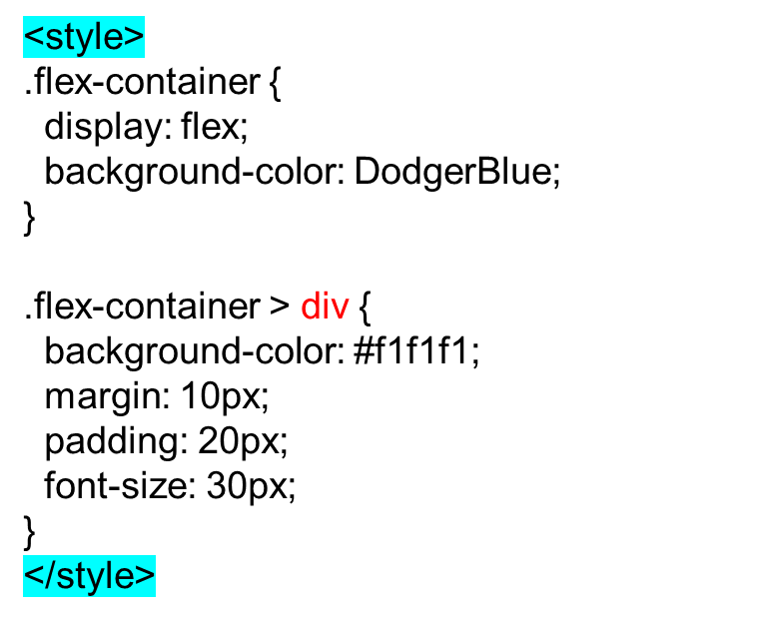
A Flex Container with Three Flex Items
To start using CSS Flexbox, you need to first define a flex container.
The flex container becomes flexible by setting the display property to flex.
Example
A flex container with three flex items:
<div class="flex-container">
<div>1</div>
<div>2</div>
<div>3</div>
</div>

Slide 9
The CSS Flex Container
Like we specified in the previous chapter, this is a flex container (the blue area) with three flex items:
The flex container becomes flexible by setting the display property to flex:
Example
.flex-container {
display: flex;
}

Slide 10
The CSS properties we use for the flex container are:
flex-direction
flex-wrap
flex-flow
justify-content
align-items
align-content

Slide 11
The CSS flex-direction Property
The flex-direction property specifies the display-direction of flex
items in the flex container.
The flex-direction property can have one of the following values:
row
column
row-reverse
column-reverse
Example
The row value is the default value, and it displays the flex items horizontally
(from left to right):
.flex-container {
display: flex;
flex-direction: row;
}

Slide 12
Example
The column value displays the flex items vertically (from top to bottom):
.flex-container {
display: flex;
flex-direction: column;
}
Example
The row-reverse value displays the flex items horizontally (but from right to left):
.flex-container { display: flex;
flex-direction: row-reverse;
}

Slide 13
Example
The column-reverse value displays the flex items vertically
(but from bottom to top):
.flex-container {
display: flex;
flex-direction: column-reverse;
}
The CSS flex-wrap Property
The flex-wrap property specifies whether the flex items should wrap or not,
if there is not enough room for them on one flex line.
The flex-wrap property can have one of the following values:
nowrap
wrap
wrap-reverse
Example
The nowrap value specifies that the flex items will not wrap (this is default):
.flex-container {
display: flex;
flex-wrap: nowrap;
}

Slide 14
Example
The wrap value specifies that the flex items will wrap if necessary:
.flex-container {
display: flex;
flex-wrap: wrap;
}
Example
The wrap-reverse value specifies that the flex items will wrap
if necessary, in reverse order:
.flex-container {
display: flex;
flex-wrap: wrap-reverse;
}

Slide 15
The CSS flex-flow Property
The flex-flow property is a shorthand property for setting
both the flex-direction and flex-wrap properties.
Example
.flex-container {
display: flex;
flex-flow: row wrap;
}

Slide 16
The CSS justify-content Property
The justify-content property is used to align the flex items
when they do not use all available space on the main-axis (horizontally).
The justify-content property can have one of the following values:
center
flex-start
flex-end
space-around
space-between
space-evenly
Example
The center value positions the flex items in the center
of the container:
.flex-container {
display: flex;
justify-content: center;
}

Slide 17
Example
The flex-start value positions the flex items at the beginning
of the container (this is default):
.flex-container {
display: flex;
justify-content: flex-start;
}
Example
The flex-end value positions the flex items at the end
of the container:
.flex-container {
display: flex;
justify-content: flex-end;
}

Slide 18
Example
The space-between value displays the flex items with space between them:
.flex-container {
display: flex;
justify-content: space-between;}
Example
The space-around value displays the flex items with space around them:
.flex-container {
display: flex;
justify-content: space-around;
}
Example
The space-evenly value displays the flex items with equal space around them:
.flex-container {
display: flex;
justify-content: space-evenly;
}

Slide 19
The CSS align-items Property
The align-items property is used to align the flex items
when they do not use all available space on the cross-axis (vertically).
The align-items property can have one of the following values:
center
flex-start
flex-end
stretch
baseline
normal
Example
The center value positions the flex items in the middle of the container:
.flex-container {
display: flex;
height: 200px;
align-items: center;
}
flex-start
flex-end
stretch
baseline
normal

Slide 20
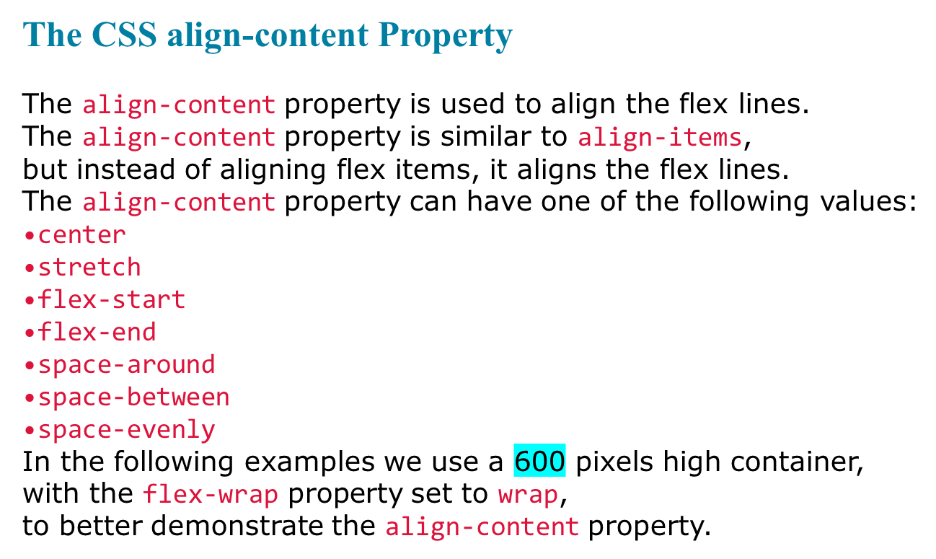
Example
With center, the flex lines are packed toward the center of the container:
.flex-container {
display: flex;
height: 600px;
flex-wrap: wrap;
align-content: center;
}
stretch
flex-start
flex-end
space-around
space-between
space-evenly

Slide 21
Perfect Centering
In the following example we will solve a common style problem: perfect centering.
SOLUTION
Set both the justify-content and align-items properties to center,
and the flex item will be perfectly centered:
Example
.flex-container {
display: flex;
height: 300px;
justify-content: center;
align-items: center;
}

Slide 22
The CSS Flex Items
The direct child elements of a flex container automatically becomes flex items.
Example
<div class="flex-container">
<div>1</div>
<div>2</div>
<div>3</div>
<div>4</div>
</div>

Slide 23
The order Property
The order property specifies the order of the flex items inside the flex container.
The first flex item in the code does not have to appear as the first item in the layout.
The order value must be a number, default value is 0.
The CSS properties we use for flex items are:
order
flex-grow
flex-shrink
flex-basis
flex
align-self

Slide 24
Example
The order property can change the order of the flex items:
<div class="flex-container">
<div style="order: 3">1</div>
<div style="order: 2">2</div>
<div style="order: 4">3</div>
<div style="order: 1">4</div>
</div>
The flex-grow Property
The flex-grow property specifies how much a flex item
will grow relative to the rest of the flex items.
The value must be a number, default value is 0.

Slide 25
Example
Make the third flex item grow eight times faster than the other flex items:
<div class="flex-container">
<div style="flex-grow: 1">1</div>
<div style="flex-grow: 1">2</div>
<div style="flex-grow: 8">3</div>

Slide 26
The flex-shrink Property
The flex-shrink property specifies how much a flex item
will shrink relative to the rest of the flex items.
The value must be a number, default value is 1.
Example
Do not let the third flex item shrink as much as the other flex items:
<div class="flex-container">
<div>1</div>
<div>2</div>
<div style="flex-shrink: 0">3</div>
<div>4</div>
<div>5</div>
<div>6</div>
<div>7</div>
<div>8</div>
<div>9</div>
<div>10</div>
</div>

Slide 27
The flex-shrink Property
The flex-shrink property specifies how much a flex item
will shrink relative to the rest of the flex items.
The value must be a number, default value is 1.
The align-self Property
The align-self property specifies the alignment for the selected item
inside the flexible container.
The align-self property overrides the default alignment set by the
container's align-items property.
Example
Align the third flex item in the middle of the container:
<div class="flex-container">
<div>1</div>
<div>2</div>
<div style="align-self: center">3</div>
<div>4</div>
</div>

Slide 28
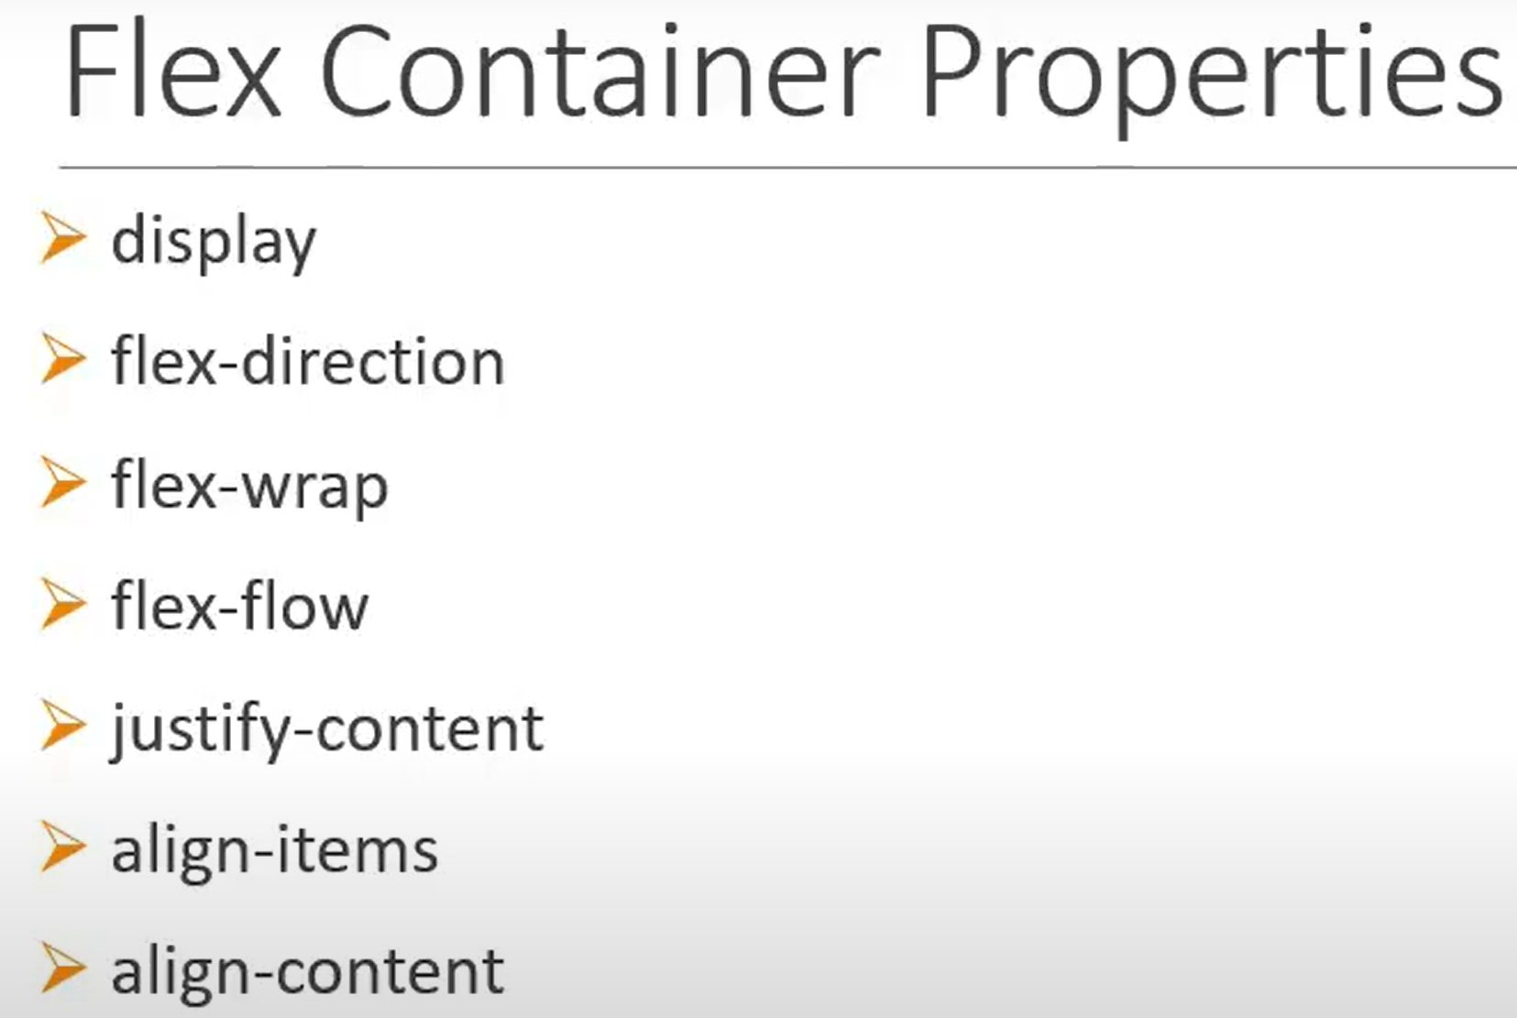
Combination of flex-direction and flex-wrap
Defines the direction of items among the main axis
Defines the layout of items among the cross axis
Similar to the justify-content and its useful when there are a lot of rows in the container

Slide 29
Practicing session
Flex Container Properties
Display:flex; but unnecessary space will appear
Display:inline-flex; unnecessary space will be removed
Flex-direction:row; or Flex-direction:row-reverse;
Flex-direction:column; or Flex-direction:column-reverse;
Flex-wrap:Nowrap; Flex-wrap:wrap;
Flex-wrap:wrap-reverse; or Flex-flow:row wrap-reverse;
Justify-content:flex-start; or flex-end; center; space-between; space-arround; space-evenly;
Align-items:stretch; flex-start; flex-end; center;
Flex ItemProperties---
Order: 1; etc.
Flex-grow:1; by default its 0;
Flex-shirink:4;
Align-self:flex-start; flex-end; center;

Slide 30
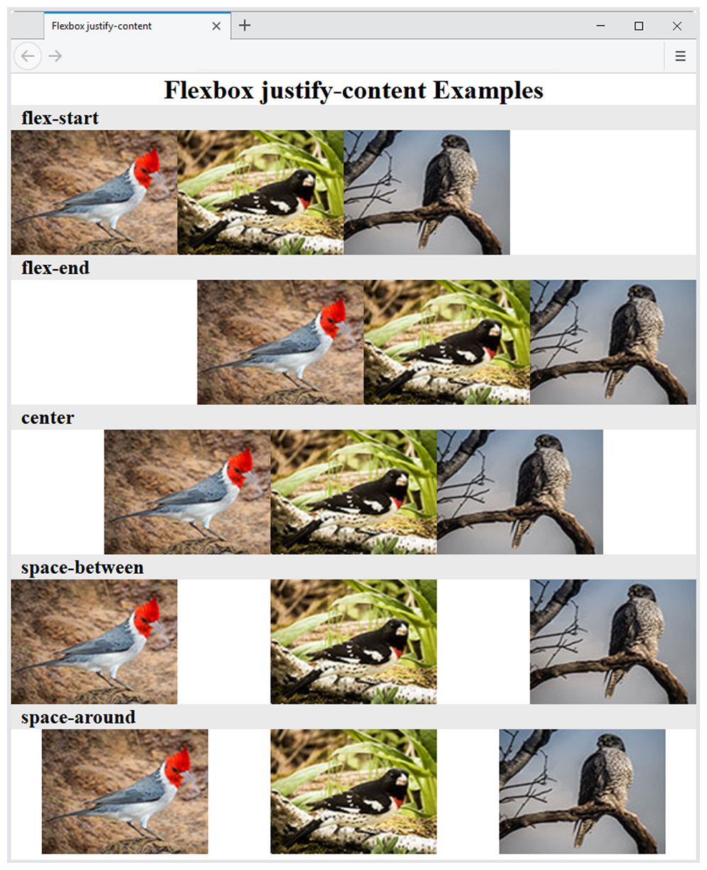
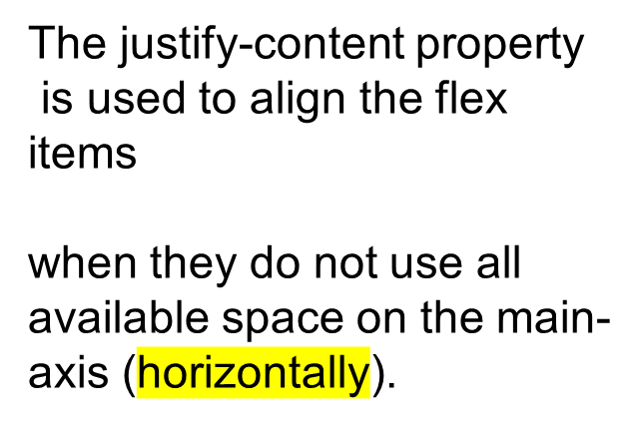
The justify-content Property
Configures how the extra space along the main axis should be displayed

Slide 31
More flexbox Properties
The align-items Property
  Configures how the browser displays extra space along the cross-axis
The flex-flow Property
  Shorthand to configure flex-direction and flex-wrap properties
The order Property
  Causes the browser to display flex items in different order than they are coded
  Warning – this could be an accessibility issue

Slide 32
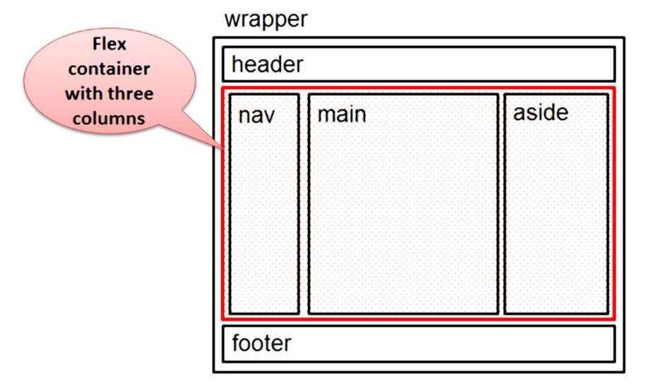
Configure Flex Items
By default flex items are flexible in size and allocated the same amount of space in the flex container
The flex property
  Customizes the size of each flex item
  Indicated the flex grow factor
  Indicates the flex shrink factor
  Can be used to indicate a proportional flexible item
nav { flex: 1; }
main { flex: 7; }
aside { flex: 2; }

Slide 33
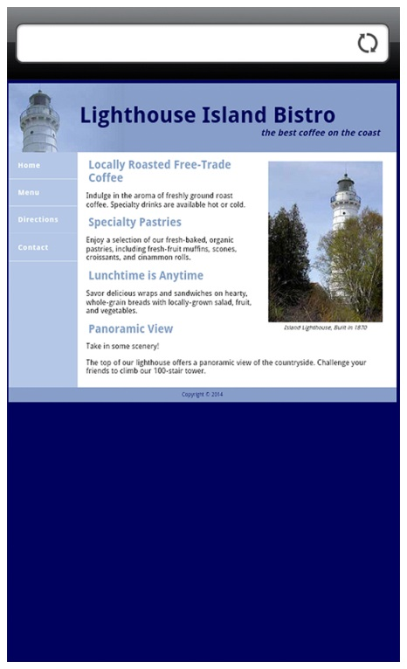
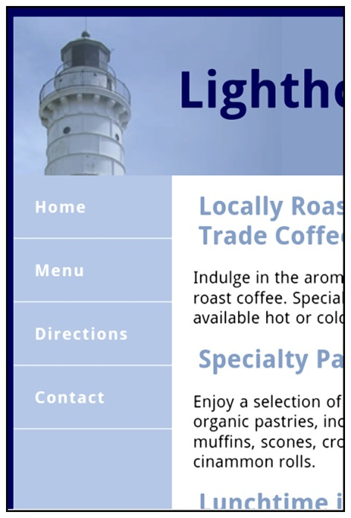
Viewport Meta Tag
Default action for most mobile devices is to zoom out and scale the web page
Viewport Meta Tag
  Created as an Apple extension to configure display on mobile devices
  Configures width and initial scale of browser viewport
<meta name="viewport"
content="width=device-width, initial-scale=1.0">

Slide 34
C S S Debugging Tips
Manually check syntax errors
Use W 3 C C S S Validator to check syntax errors
  http://jigsaw.w3.org/css-validator/
Configure temporary background colors
Configure temporary borders
Use C S S comments to find the unexpected
/* the browser ignores this code */
Don’t expect your pages to look exactly the same in all browsers!
Be patient!

Slide 35
Summary
This chapter expanded your C S S and H T M L skillset.
You configured web pages with C S S Flexible Box Layout (flexbox).
You configured web pages for mobile display using the viewport meta tag.

Slide 36

Copyright
This work is protected by United States copyright laws and is provided solely for the use of instructors in teaching their courses and assessing student learning. Dissemination or sale of any part of this work (including on the World Wide Web) will destroy the integrity of the work and is not permitted. The work and materials from it should never be made available to students except by instructors using the accompanying text in their classes. All recipients of this work are expected to abide by these restrictions and to honor the intended pedagogical purposes and the needs of other instructors who rely on these materials.

